Slide 1
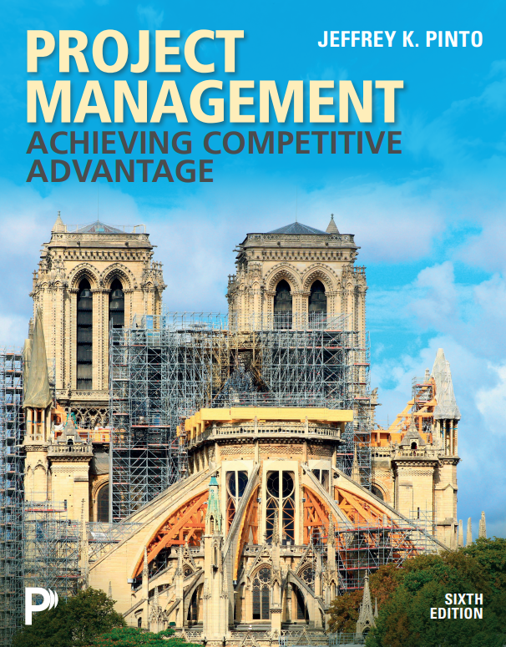

What’s New?
• NEW AI-Focused Engagement Exercises
• NEW PMBoK 8th edition Updates & PMP Exam Prep Questions
• Step-by-Step Microsoft Project Tutorial Guides
Pearson+ eText delivers Interactive Figures, Current Event Updates, Embedded Questions, and an AI-Powered Study Tool!
NEW! MyLab Course offers AI Engagement Assignments, Dynamic Study Modules, Excel Projects, Mini Sims, Video Lecture Quizzes, and more!
6th Edition hallmark features include Hands-On Project Planning, End-of-Chapter Case Studies, and Exercises!
https://www.pearson.com/en-us/subject-catalog/p/project-management-achieving-competitive-advantage/P200000013493?view=educator&tab=title-overview
MyLab OM Project Management: Achieving Competitive Advantage ISBN: 9780135421031
Pearson eText Project Management: Achieving Competitive Advantage ISBN: 9780135421086

